Slide 1
Name->Rohit Jaggi Roll No->2010992059
Instructor-Mr. Lavish Arora

Slide 2
RJ E-Site
Contents :
About the Website
Different pages
Design Philosophy
Future prospects

Slide 3
About the website
I have created E- commerce website selling electronic products.
Website contains a home page,login ,category,signup,About us , and feedback Page.

Slide 4
Future Prospects
In future Subcategory page , animation
The website can be made more attractive by use of javascript and bootstrap
I plan on using react in my website for creating incredible ui/ux.
The animations and subcategory page can be more smooth and visually appealing respectively.

Slide 5



Different sites we are going on.
Inasdiaiinn
Instagram
Facebook
Google

Slide 6
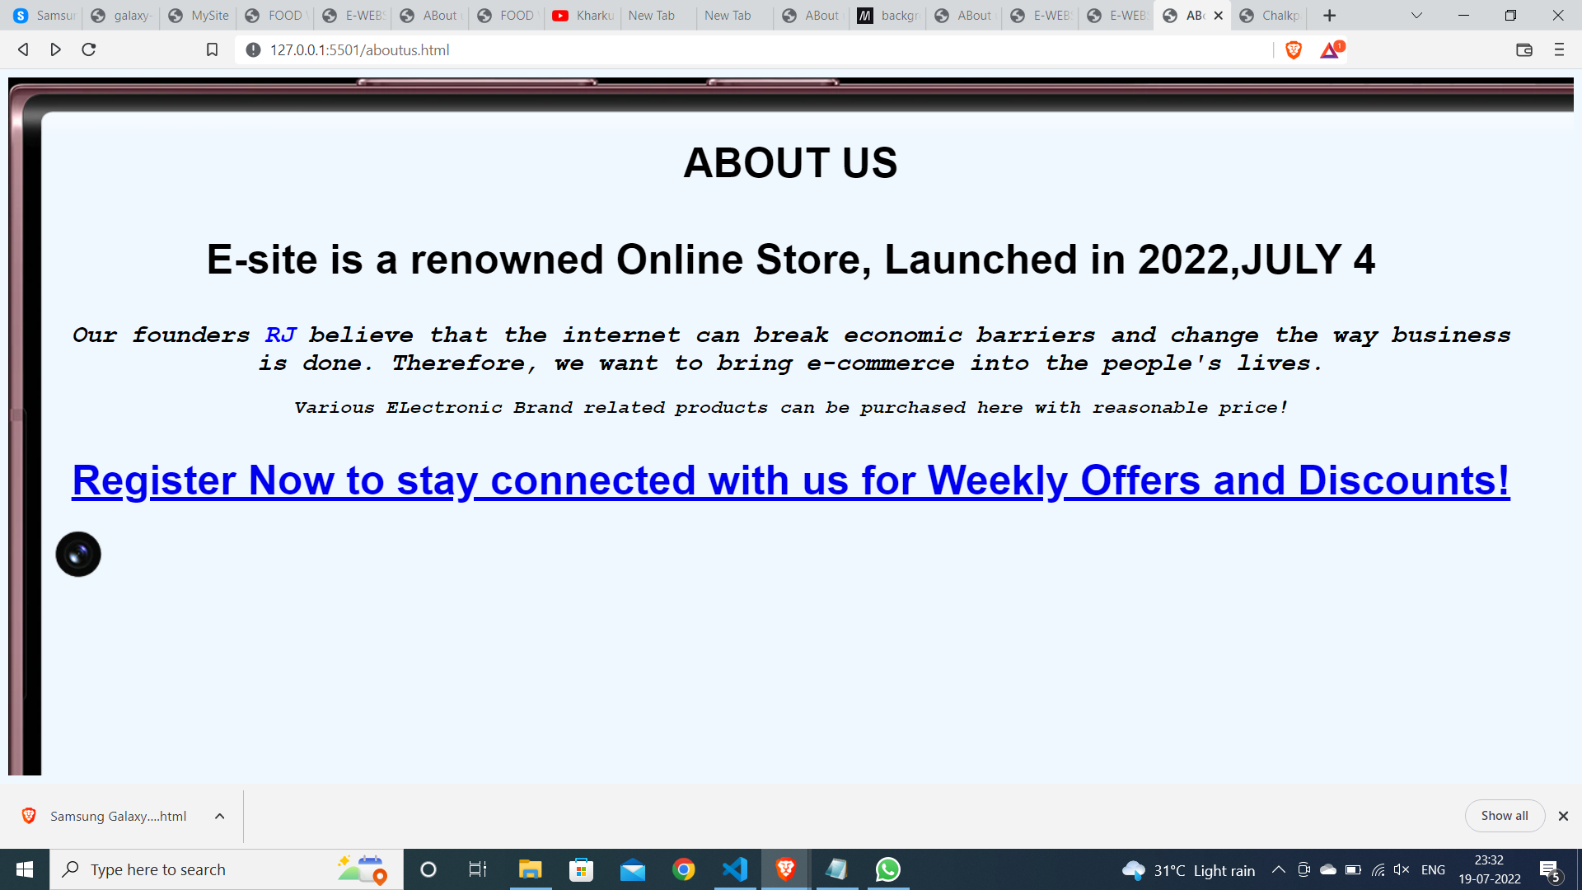

Slide 7
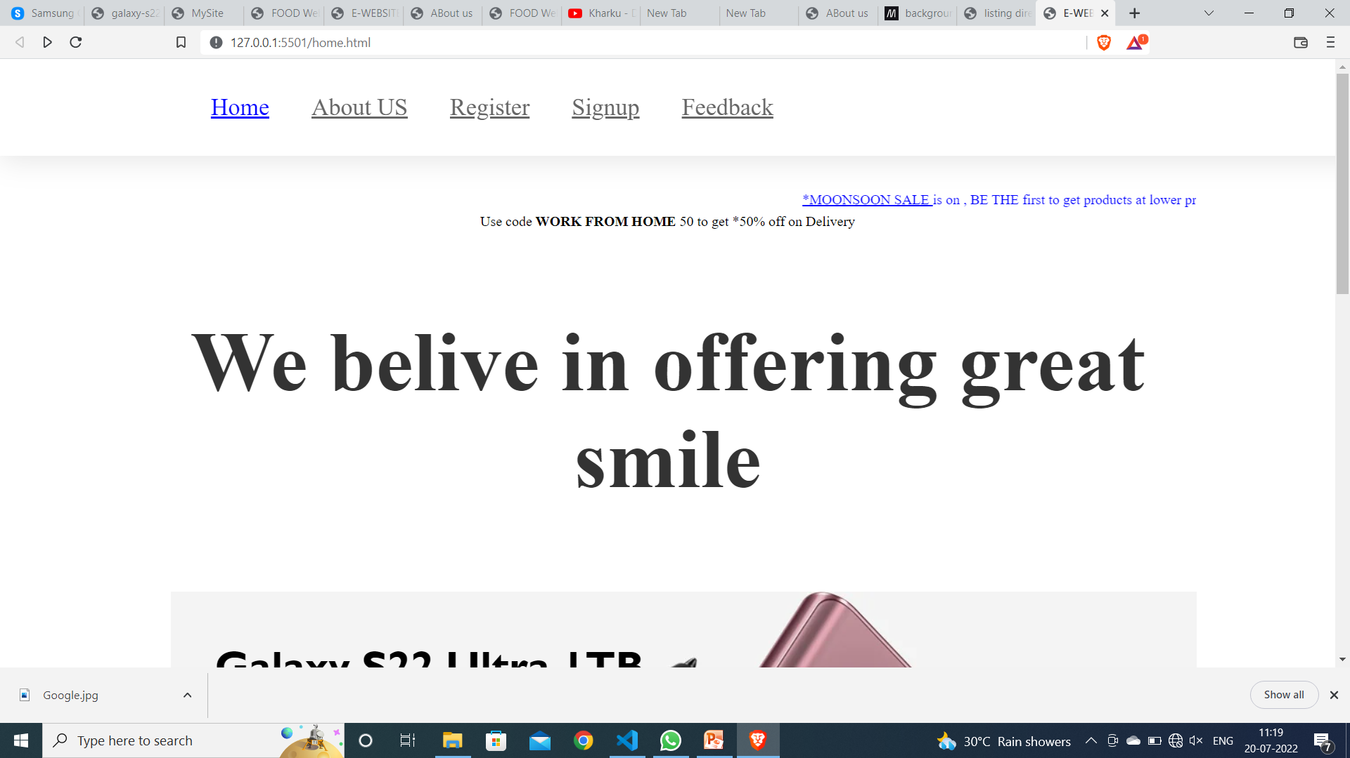
Home page

Slide 8
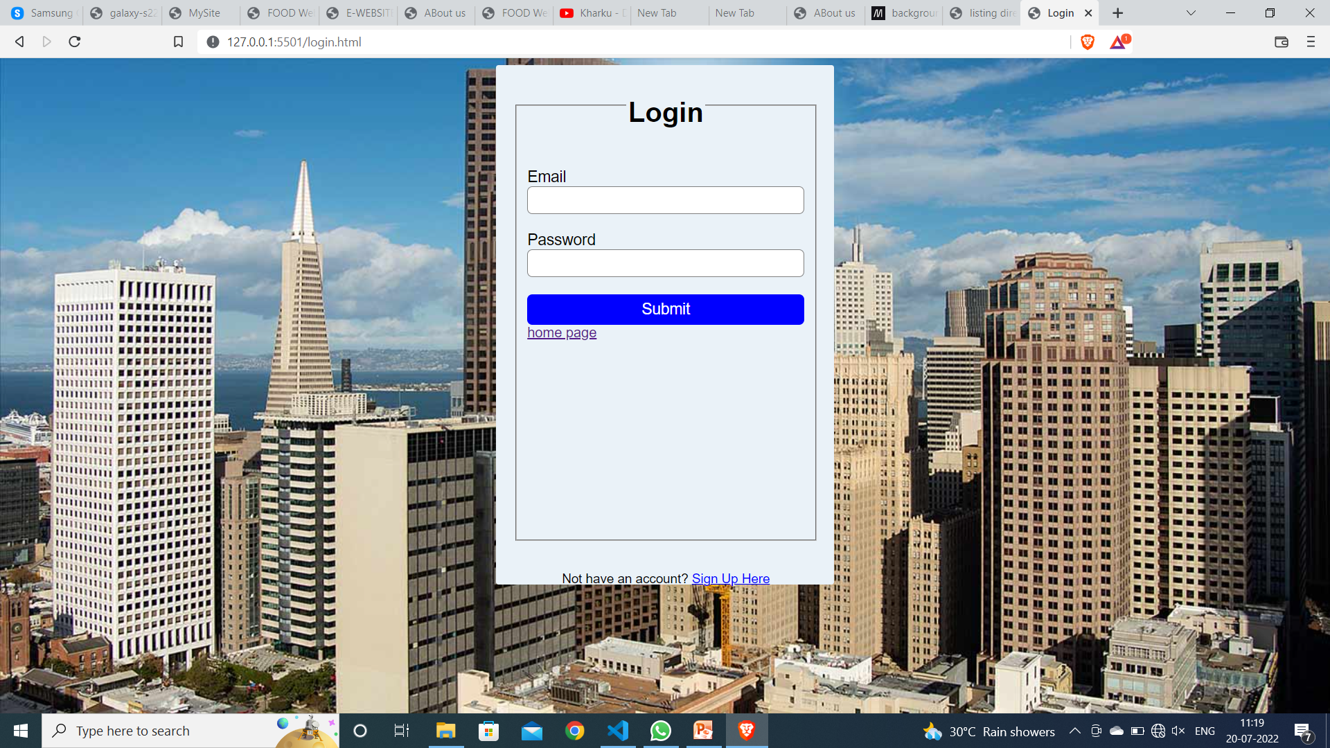

Slide 9
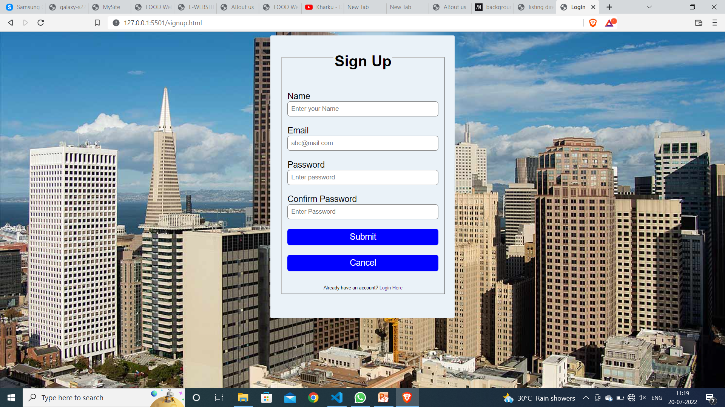

Slide 10
